Slide 1
Drive Module System Solution

Slide 2
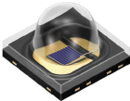
Image Sensor + Power Supply + IR LED driver
Video Processor
Smart FET
NCV47822
12.0V
~ 1.7W
Buck
NCV890430
393mW***
3.0V
Buck
NCV6324 ~33mW
1.2V
VDD/V
DD_PHY 189mA
LDO
NCV8163 ~ 37mW
2.8V
VAA/VAAPIX 70mA
Sensor
AR0144
AR0135
457mW
Buck
NCV6324 ~ 68mW
E2PROM
CAV24C64
Connector
1.8V
VDDIO 177mA
RAW data
Smart FET
NCV84160
LED Flash
PWM Dimming
200uS to 1mS pulse, period 16.6 mS or 20 mS
12.0V 2A
LED Driver
NCV30161
6V/3A/1mS max
IR LED
driver board
SFH4725
SFH4727

Slide 3
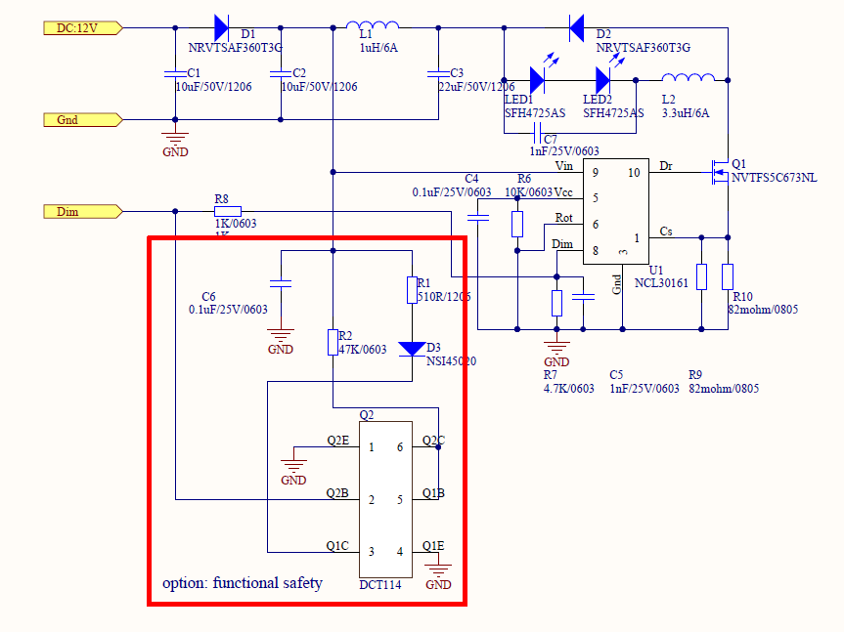
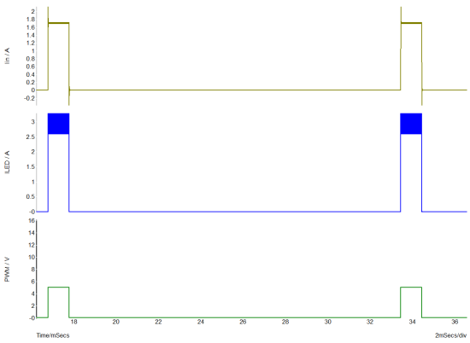
IR LED driver
Smart FET
NCV84160
Average input power 1.1W
4.7uH
LED driver fault diagnosis：
When Flash(DIM) is high, the LED flashlight current is high also, more than 20mA. The constant current source can be turned off immediately.
When PWM low, no current through LED lamp, the input current is low from DC/DC converter. To turn on constant current source to avoid fault diagnosis.
Flashlight duration：200uS to 1mS
LED flashlight DC current setting：
ILED=200mV/Rsense
Optional current source
How to control pulse for flashlight?
Change R8 to 0.1uF capacitor, change C5 to diode. To realize PWM control by differential method of input pulse.

Slide 4
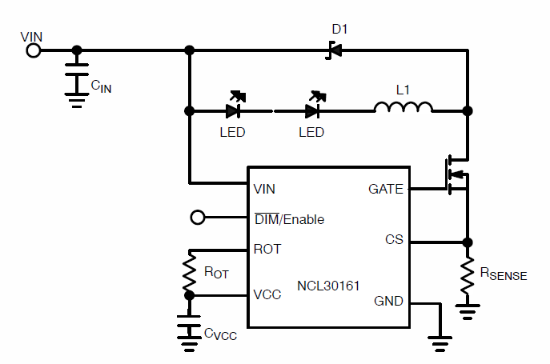

NCV30161 - Buck Regulator for Driving High Power LEDs
The NCV30161 is a hysteretic step−down, constant−current driver for high power LEDs. Ideal for automotive, industrial and general lighting applications utilizing minimal external components.
Features
Typical Application diagram & Package info
VIN Range 6.3 V to 40 V
Short LED Shutdown Protection
No Control Loop Compensation Required
Adjustable LED Current
Single Pin Brightness and Enable/Disable Control Using PWM
Supports All−Ceramic Output Capacitors and Capacitor−less Outputs
Thermal Shutdown Protection
Capable of 100% Duty Cycle Operation
Tj = -40C to 125C (Grade 1)
AECQ100 Qualified and PPAP capable
Benefits
Benefits
Hysteretic control provides good power supply rejection and fast response during load transients
Dedicated PWM input (DIM/EN) enables a wide range of pulsed dimming
Uses smaller external components minimizing space and cost.
Protection features include resistor−programmed constant LED current, shorted LED protection, under−voltage and thermal shutdown.
Ordering info & Support
NCV30161MNWTXG
Package– 3mm x 3mm DFN10 with wettable flanks

